Slide 1












MOTION – POSE CLASSIFICATION
BY :-
Jubisha Prajapati

Slide 2
TABLE OF CONTENTS
01
04
Introduction
Libraries used
02
05
Workflow
Objective
03
Tools used
06
Conclusion

Slide 3
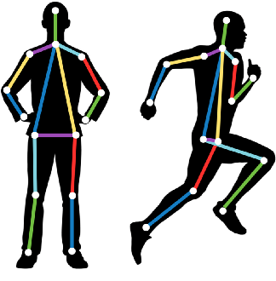
MOTION POSE CLASSIFICATION
Motion pose classification in Python involves the task of recognizing and classifying human poses or movements from video or sensor data.
Motion pose refers to the specific configuration or arrangement of an object, typically a human body, in a particular state of motion.
Motion pose analysis is often used in computer vision, robotics, animation, and other fields to understand and interpret human movements and gestures.

Slide 4
OBJECTIVE
To gain knowledge
To learn about data science ,data analysis and machine learning
To develop skills

Slide 5



TOOLS USED

Slide 6

LIBRARIES USED
Pandas
Scikit-learn
Seaborn

Slide 7
WORK FLOW
Import all the necessary libraries.
Load the data.
3. Perform EDA (Exploratory Data Analysis)
(i.) Null Values Check
(ii.) Duplicated Rows Check
4. Feature Engineering
i. Correlation
ii. Removed poorly correlated columns
5. Split the data into independent and dependent features(x , y).
6. Split the data into train and test set.
7. Create the instance of the model
8. Fill the data into algorithm
9. Check the matrices(loss/Accuracy).

Slide 8
DATA LOADING
Import necessary libraries.
Load the dataset into a dataframe i.e. data.

Slide 9


PERFORM EDA
Null Values
Either remove or fill.
Duplicate values
Remove.

Slide 10
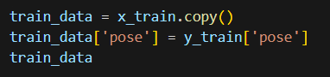

MERGING
The train datasets are merged to compute correlation and derive heatmap.

Slide 11
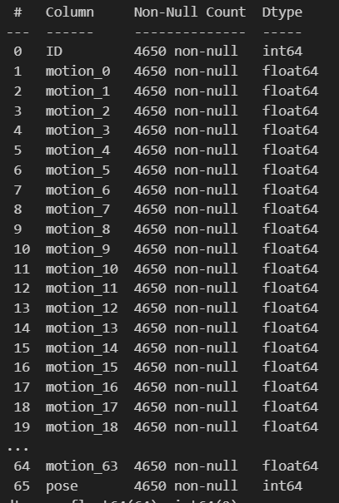
DATASET INFORMATION
Two columns of int type
(ie. ID and Pose)
All others are float type.

Slide 12
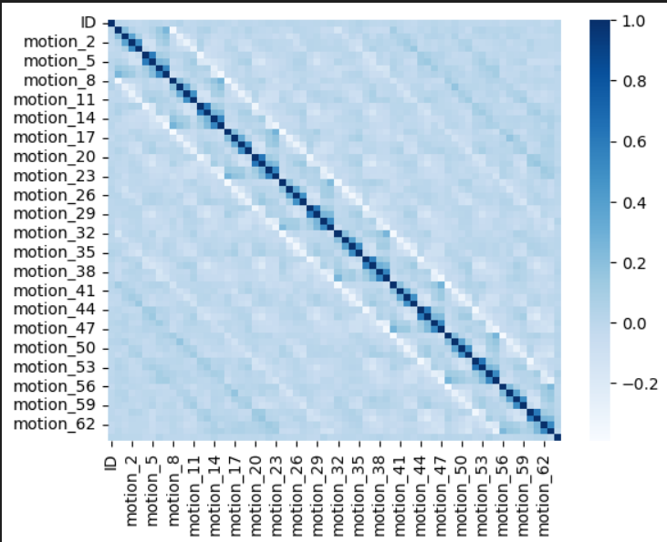
VISUALIZATION
Visualization is a crucial aspect of data analysis and understanding your data in Python.
Dark Blue: Strong positive correlation (values closer to +1)
Light Blue: Weaker or no significant correlation (values closer to 0)

Slide 13
SPLITING INTO TRAIN AND TEST
The dataset was split into a training set (80%) and a testing set (20%)

Slide 14

ACCURACY
It refers to the measure of how well a model or algorithm performs in making correct predictions or classifications.
Here, logistic regression and decision tree are used.

Slide 15
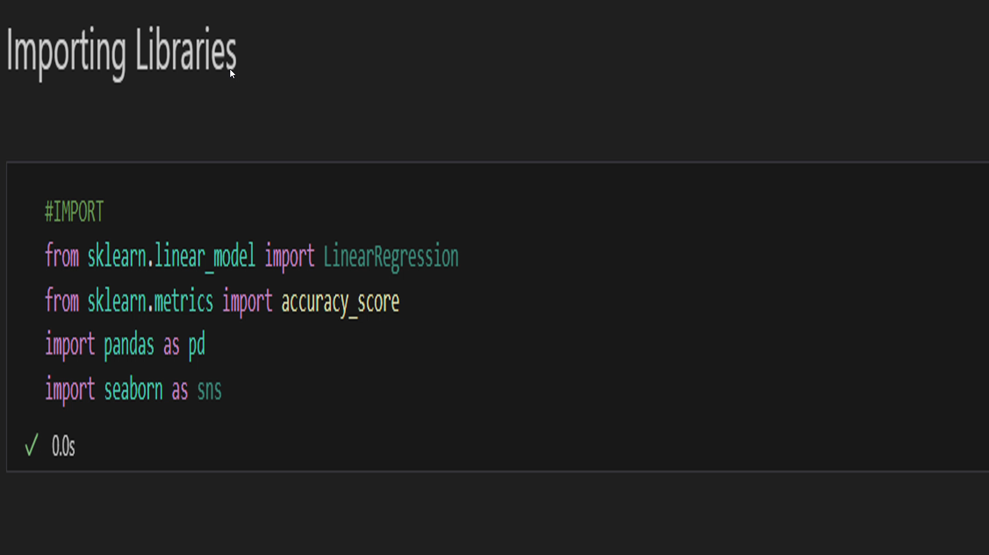
DEMO VIDEO

Slide 16
CONCLUSION
Enhanced data handling and analysis skills.
Understanding the importance of model selection and evaluation.
Overall through this project, we have learned how to harness the power of Python and its libraries, such as NumPy, Pandas, Matplotlib, and Scikit-Learn, to build a predictive model for estimating motion poses

Slide 17
THANK YOU

